Slide 1
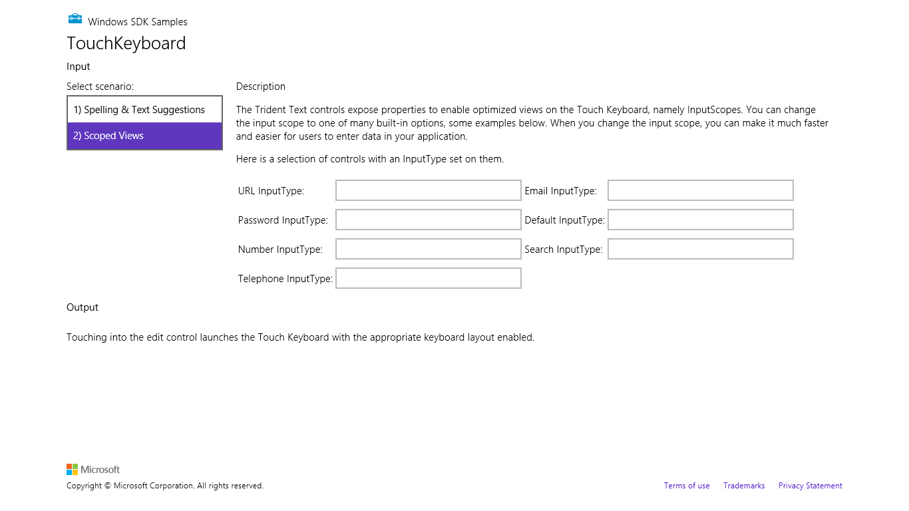
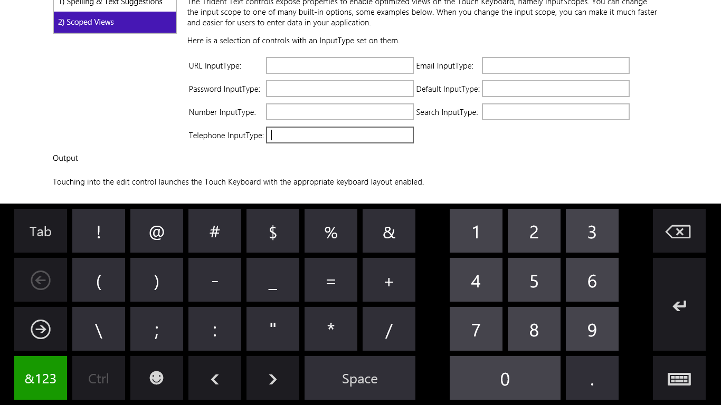
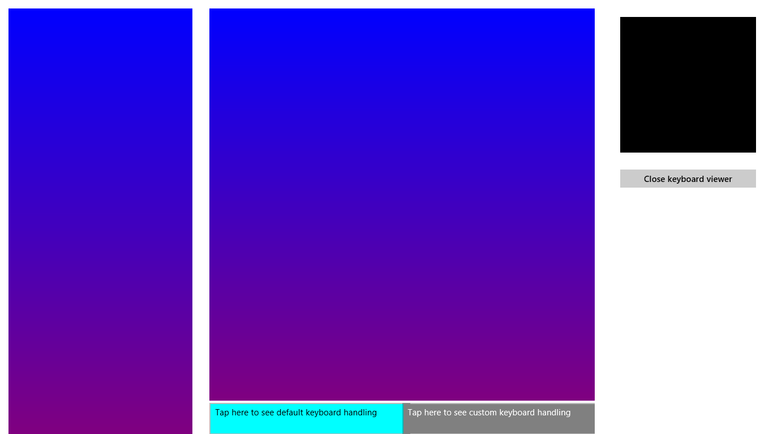
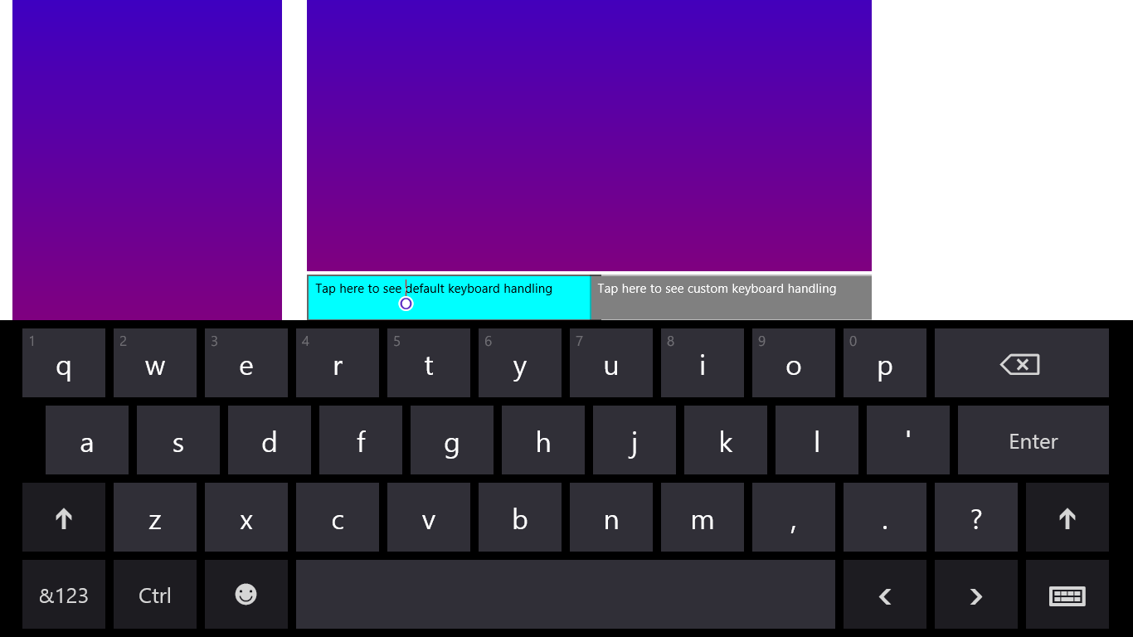

Slide 2
Horizontal threshold
pointerdown
Vertical threshold
pointermove (many events)
pointerup >> MSGestureTap
pointerup and MSGestureEnd
pointerdown
MSGestureStart
MSGestureChange (zero or more events)

Slide 3
pointerup and MSInertiaStart
MSGestureStart
MSGestureChange
MSGestureEnd
MSPointerOver
MSPointerDown
MSPointerMove
MSPointerUp
MSPointerOver

Slide 4
Inertia release point (MSInertiaStart)
Continued movement without pointer contact (MSGestureChange)
Movement
Inertia
Movement follows pointer
(MSGestureChange)
Manipulation release point
(MSGestureEnd)
Movement complete
(MSGestureEnd)
Manipulation
Gesture detected
(MSGestureStart)
Time

